Slide 1

Multi-Level Integrity
CIS 360 – Prof. C. R. Johnson
University of Wisconsin – Stevens Point

Slide 2
Data Integrity: Defined
“The extent to which all data are complete, consistent and accurate throughout the data lifecycle.”*
Applies to both electronic and paper records.
From creation, processing/manipulation, temporary and long-term storage, archiving through destruction.

Slide 3
Importance of Data Integrity
Documentary evidence relies on data integrity
Lack of data integrity jeopardizes the ability to rely on records to show compliance
Receiving increased emphasis in many industries
Notes:
Compliance to procedures, regulatory requirements, work instructions, etc.

Slide 4
Data Integrity in Our Lives
Financial Transactions
Brokerage
Sales
On-line and in-store
Ransomware attack
Colonial Pipeline
Maintenance Records
Scheduled auto service
Aircraft repair
Healthcare Records
Vaccination card
Vaccine passport

Slide 5
ALCOA
Per FDA guidance, data needs to be:
Attributable
Identity of person
Legible
Readable and permanent
Contemporaneous
Recorded at time of the task or measurement
Original
File or format preserves the integrity of all elements
Accurate
Reliable

Slide 6
Attributable
Data is uniquely identified as executed by the individual or electronic system.
Entries on paper record signed and dated
Linked to author
Electronic record linked to user ID
Computer audit trail enabled, or
Log shows who used the system and for what activity

Slide 7
Definition
Audit Trail: Metadata associated with actions related to creation, modification or deletion of computer records.
Facilitates reconstruction of all activities related to the record regardless of medium
Includes “who, what, when and why” of the activity.

Slide 8
Definition
Metadata: contextual information required to understand data
Identity of the analyst, clerk, administrator…
Unit of measure
Date and time stamp

Slide 9
Legible
Data is readable and understandable. Changes to data do not obscure original data.
Changes to electronic record are retained
Display changes in human readable format
Retain legacy systems through data lifecycle

Slide 10
Contemporaneous
Data is recorded simultaneous with when it is generated, an activity occurs, or an observation is made.
Traceable to individual
Electronic: File is saved immediately after the activity
Best practice: Instrument linked to computer system
Best practice: Barcode scan used to perform the transaction

Slide 11
Original
Record of data as observed with associated metadata, if applicable. Data captured in a dynamic record remains available in a dynamic state.
Preserves the accuracy, completeness, content, and meaning
Permanent storage of electronic file
No storage in temporary media outside of audit trail
Thumb or jump drive

Slide 12
Definitions
Dynamic Record: a record, usually electronic, that allows for an interactive relationship between the user and the record content.
Electronic integration of chromatogram followed by printing
Metadata must be retained
Static Record: a record, usually on paper or in PDF format that is fixed, allowing little or no interaction between the user and the record content.
Spectra direct to printer

Slide 13
Accurate
Data is correct, truthful, valid, and reliable
Facilitated through Quality Management System
Culture of truthfulness
Employee training
Adequate supervision
Calibrated instruments
Maintenance of devices
Verification of transcribed data

Slide 14
ALCOA+
Complete
Electronic record includes metadata
Paper record includes all scrap paper and printout
Consistent
Data organized logically such as chronologically
Good Documentation Practices are followed
Enduring
Durable and protected
Available
Retrievable and readable
Notes:
Good Documentation Practices were discussed under Legible

Slide 15
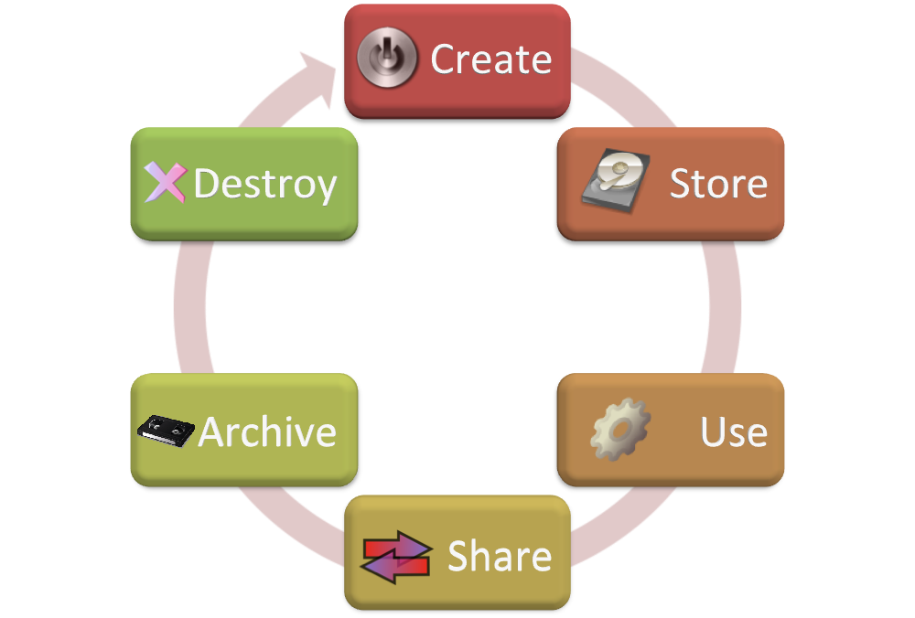
The Data Lifecycle
Procedures direct conformance to requirements
Training facilitates conformance
Audit confirms adherence

Slide 16
Data Integrity Issues
Record deficiencies:
Completion of production records days after the activity
Destruction of original data after transcription
Destruction of original data after retest
Incomplete test records
Improper validation of data
Unauthorized changes to paper records
Original data in the designated waste area

Slide 17
Computer Systems
User access limited to job requirement
Unique login, or:
Overlay third-party software, or
Use paper log for traceability
Audit Trail
Only System Administrator can disable
System Administrator has no direct interest in data
Not a quality unit person
Maintain legacy software for retrieval
Notes:
Programmable Logic Controllers and Distributed Control Systems used in chemical plants generally are open systems.

Slide 18
Systems Design
Facilitate compliance:
Common clock for time at point of use
Data recorded at point of use
Control of blank forms
Reconcile controlled print-out
Unique user access control
Retention
Secured computer system
Verified backup copy
Notes:
In sterile manufacture, it is acceptable to have an individual act as a scribe to record the data outside of the clean room to protect the product.

Slide 19
Biba Integrity Model
The Biba integrity model was published in 1977 at the Mitre Corporation, one year after the Bell La-Padula model was published.
The primary motivation for creating this model is the inability of the Bell-LaPadula model to deal with integrity of data.
The Biba model addresses the problem with the star property of the Bell-LaPadula model, which does not restrict a subject from writing to a more trusted object.

Slide 20
Integrity
Integrity refers to the trustworthiness of data or resources.
Integrity is usually defined in terms of preventing improper or authorized change to data.
There are three main goals of integrity:
Preventing unauthorized users from making modifications to data or programs.
Preventing authorized users from making improper or unauthorized modifications.
Maintaining internal and external consistency of data and programs.

Slide 21
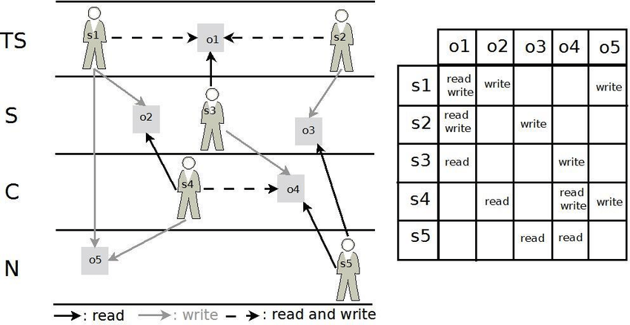
BIBA Model – read up, write down
The inverse of Bell-LaPadula used in corporate structures because where as BLP is for keeping confidentiality, Biba is for maintaining consistency (integrity) in information from the top down.
Biba allows compartmentalization based on reporting structures. Supervisors can read/write with peers. Write to subordinates, who can read that information.

Slide 22
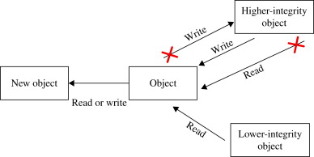

Slide 23
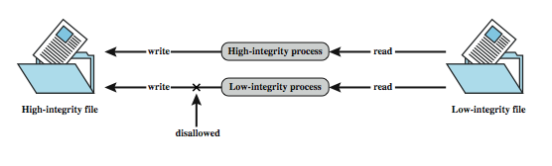
Biba Integrity Model
Various models dealing with integrity
Strict integrity policy:
Simple integrity: modify only if I(S) ≥ I(O)
Integrity confinement: read only if I(S) ≤ I(O)
Invocation property: invoke/comm only if I(S₁) ≥ I(S₂)
Notes:
The Biba [BIBA77] models deals with integrity, and is concerned with the unauthorized modification of data. The basic elements of the Biba model are like the BLP model. As with BLP, the Biba model deals with subjects and objects. Each subject and object is assigned an integrity level, denoted as I(S) and I(O) for subject S and object O, respectively. A simple hierarchical classification can be used, in which there is a strict ordering of levels from lowest to highest. Biba then proposes a number of alternative policies that can be imposed on this model. The most relevant is the strict integrity policy, based on the following rules:
• Simple integrity: A subject can modify an object only if the integrity level of the subject dominates the integrity level of the object: I(S) ≥ I(O).
• Integrity confinement: A subject can read on object only if the integrity level of the subject is dominated by the integrity level of the object: I(S) ≤ I(O).
• Invocation property: A subject can invoke another subject only if the integrity level of the 1st subject dominates the integrity level of the 2nd subject: I(S₁) ≥ I(S₂).
The simple integrity rule is the logical write-up restriction that prevents contamination of high-integrity data. Figure 10.4 illustrates the need for the integrity confinement rule. A low-integrity process may read low-integrity data but is prevented from contaminating a high-integrity file with that data by the simple integrity rule. If only this rule is in force, a high-integrity process could conceivably copy low-integrity data into a high-integrity file. Normally, one would trust a high-integrity process to not contaminate a high-integrity file, but an error in the code or a Trojan horse could result in such contamination. Hence the need for the integrity confinement rule.

Slide 24
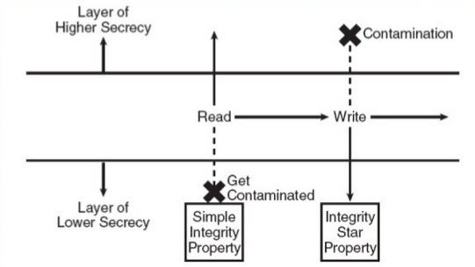
Biba Integrity Model
Simple integrity: modify only if I(S) ≥ I(O)
Integrity confinement: read only if I(S) ≤ I(O)
Invocation property: invoke/comm only if I(S₁) ≥ I(S₂)
Notes:
The Biba [BIBA77] models deals with integrity, and is concerned with the unauthorized modification of data. The basic elements of the Biba model are like the BLP model. As with BLP, the Biba model deals with subjects and objects. Each subject and object is assigned an integrity level, denoted as I(S) and I(O) for subject S and object O, respectively. A simple hierarchical classification can be used, in which there is a strict ordering of levels from lowest to highest. Biba then proposes a number of alternative policies that can be imposed on this model. The most relevant is the strict integrity policy, based on the following rules:
• Simple integrity: A subject can modify an object only if the integrity level of the subject dominates the integrity level of the object: I(S) ≥ I(O).
• Integrity confinement: A subject can read on object only if the integrity level of the subject is dominated by the integrity level of the object: I(S) ≤ I(O).
• Invocation property: A subject can invoke another subject only if the integrity level of the 1st subject dominates the integrity level of the 2nd subject: I(S₁) ≥ I(S₂).
The simple integrity rule is the logical write-up restriction that prevents contamination of high-integrity data. Figure 10.4 illustrates the need for the integrity confinement rule. A low-integrity process may read low-integrity data but is prevented from contaminating a high-integrity file with that data by the simple integrity rule. If only this rule is in force, a high-integrity process could conceivably copy low-integrity data into a high-integrity file. Normally, one would trust a high-integrity process to not contaminate a high-integrity file, but an error in the code or a Trojan horse could result in such contamination. Hence the need for the integrity confinement rule.

Slide 25
Integrity Levels
Integrity levels are defined by labels, consisting of two parts:
a classification
a set of categories.
Integrity levels are given to the subjects and objects in the system.
Integrity labels tell the degree of confidence that may be placed in the data.

Slide 26
Classification of Integrity
A classification is an element of hierarchical set of elements.
It consists of these elements:
Crucial (c)
Very Important (VI)
Important (I)
The relationship of elements is:
C > VI > I

Slide 27
Set Categories
The set of categories contained in the label will be a subset of all the sets in the system.
The classification of the set of categories is non-hierarchical.

Slide 28
Example of Set Categories
An example of two categories are category X = {Detroit, Chicago, New York} and category Y = {Detroit, Chicago}.
In this case X ≥ Y (X dominates Y), because Y is a subset of X.
If there were to be a third compartment Z containing {Detroit, Chicago, Miami}. Compartment Z and X in this case are non-comparable because the third element of the set is different.

Slide 29
Integrity Levels
Each integrity level will be represented as L = (C, S) where:
L is the integrity level
C is the classification
S is the set of categories.
The integrity levels then form a dominance relationship.
Integrity level L₁ = (C₁, S₁) dominates (≥) integrity level L₂ = (C₂, S₂) if and only if this relationship is satisfied:
C₁ ≥ C₂ and S₁ ⊇ S₂

Slide 30
Subjects and Objects
Like other models, the Biba model supports the access control of both subjects and objects.
Subjects are the active elements in the system that can access information (processes acting on behalf of the users).
Objects are the passive system elements for which access can be requested (files, programs, etc.).
Each subject and object in the Biba model will have a integrity level associated with it.

Slide 31
Access Modes
The Biba model consists of the following access modes:
Modify: the modify right allows a subject to write to an object. This mode is similar to the write mode in other models.
Observe: the observe right allows a subject to read an object. This command is synonyms with the read command of most other models.
Invoke: the invoke right allows a subject to communicate with another subject.
Execute: the execute right allows a subject to execute an object. The command essentially allows a subject to execute a program which is the object.

Slide 32
Biba Policies
The Biba model is actually a family of different policies that can be used.
The goal of the model is to prevent the contamination of “clean” high level entities from “dirty” low level entities.
The model supports both mandatory and discretionary policies.
The Mandatory Policies:
Strict Integrity Policy
Low-Watermark Policy for Subjects
Low-Watermark Policy for Objects
Low-Watermark Integrity Audit Policy
Ring Policy
The Discretionary Policies:
Access Control Lists
Object Hierarchy
Ring

Slide 33
Strict Integrity Policy
The Strict Integrity Policy is the first part of the Biba model. The policy consists of:
Simple Integrity Condition: s ∈ S can observe o∈ O if and only if i(s) ≤ i(o) (“no read-down”).
Integrity Star Property: s ∈ S can modify o∈ O if and only if i(o) ≤ i(s) (“no write-up”).
Invocation Property: s₁ ∈ S can invoke s₂ ∈ S if and only if i(s₂) ≤ i(s₁).

Slide 34
Simple Integrity Condition
“No Read-Down”
circle = subject, square = object

Slide 35
Integrity Star Property
“No Write-Up”
circle = subject, square =object

Slide 36
Strict Integrity Policy
When most people refer to the Biba model they are actually referring to the strict integrity model.
This policy is the most common policy that used from the model.
The strict integrity policy enforces “no write-up” and “no read-down” on the data in the system, which is the opposite of the Bell-LaPadula model.
This policy restricts the contamination of data at higher level, since a subject is only allowed to modify data at their level or at a lower level.

Slide 37
Strict Integrity Policy
The “no write-up” is essential, since it limits the damage that can be done by malicious objects in the system. For instance, “no write-up” limits the amount of damage that can be done by a trojan horse in the system. The trojan horse would only be able to write to objects at it integrity level or lower. This is important because it limits the damage that can be done to the operating system.
The “no read-down” prevents a trust subject from being contaminated by a less trusted object.

Slide 38
Low-Watermark Policy for Subjects
The low-watermark policy for subjects is a relaxed “no read-down”.
The low-watermark policy for subjects contains these following rules:
Integrity Star Property: s ∈ S can modify o∈ O if and only if i(o) ≤ i(s) (“no write-up”).
A subject may examine any object. If s ∈ S examines o ∈ O then i′(s) = min(i(s),i(o)), where i′(s) is the subjects integrity level after the read.
Invocation Property: s₁∈ S can invoke s₂ ∈ S if and only if i(s₂) ≤ i(s₁).

Slide 39
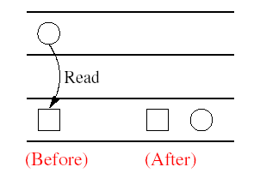
Low-watermark Policy for Subjects
circle = subject, square = object

Slide 40
Low-Watermark Policy for Subjects
The low-watermark policy for subjects does nothing to restrict a subject from reading objects.
The low-watermark policy for subjects is a dynamic policy, because it lowers the integrity level of a subject based on what objects are observed.
This policy is not without it shortcomings, one problem with this policy is that if a subject observes a less trusted object, it will drop the subjects integrity level to that of the object. Then later, if the subject needs to legitimately observe other objects, it may not be able to do so because the subjects integrity level has been lowered. The effect of this would be denial of service depending on the timing of the submissions.

Slide 41
Low-Watermark Policy for Objects
The low-watermark policy for objects is a relaxed “no write-down”.
The following rules make up the low-watermark for objects policy:
s ∈ S can modify any o ∈ O regardless of integrity level.
If s ∈ S modifies o ∈ O then i′(o) = min(i(s),i(o)), where i′(o) is the objects integrity level after it is modified.

Slide 42
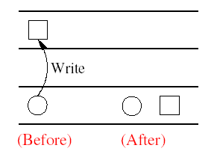
Low-Watermark Policy for Objects
circle = subject, square = object

Slide 43
Low-Watermark Policy for Objects
The low-watermark policy for objects is also a dynamic policy, similar to the low-watermark policy for subjects.
The disadvantage of this policy is it does nothing to prevent an un-trusted subject from modify a trusted object. In reality policy is not very practical.
The policy provides no real protection in a system. The policy simply lowers in the trust placed in the objects. If a malicious program was inserted into the computer system it could modify any object in the system. This model would just lower the integrity level of objects that have become contaminated.

Slide 44
Low-Watermark Integrity Audit Policy
The low-watermark integrity audit policy consists of the following rules:
Any subject may modify any object, regardless of integrity levels.
If a subject modifies an object at higher integrity level (a more trusted object), it results in the transaction being recorded in an audit log.
The drawback to this policy is it does nothing to prevent an improper modifications of an object. This policy is similar to the low-watermark for objects policy, except in this case the objects integrity level is not lowered, it is recorded.
This policy simply records that an improper modification took place.

Slide 45
Ring Policy
The ring policy is the last mandatory policy in the Biba model. Integrity labels used for the ring policy are fixed similar to those in the strict integrity policy.
The Ring Policy consists of the following rules:
Any subject can observe any object, regardless of integrity levels.
Integrity Star Property: s ∈ S can modify o∈ O if and only if i(o) ≤ i(s) (“no write up”).
Invocation Property: s₁ ∈ S can invoke s₂ ∈ S if and only if i(s₂) ≤ i(s₁).

Slide 46
Ring Policy
The Ring Policy allows any subject to observe any object. This policy is only concerned with direct modification.
The drawback to this policy is it allows improper modifications to indirectly take place.
A subject can read a less trusted object. Then the subject could modify the data it observed at its own integrity level.
An example of this would be a user reading a less trusted object, then remember the data that they read and then at a later time writing that data to an object at their own integrity level.

Slide 47
Current implementations of the Biba Model
One instance of where the Biba model is currently used is in FreeBSD 5.0.
The TrustedBSD MAC framework is a kernel security framework that is an extension of FreeBSD 5.0.
The Biba Integrity Model is supported by a module called mac_biba.ko.
The integrity levels are defined for subjects and objects in a configuration file.
The Biba policy in FreeBSD 5.0 provides support for both hierarchical and non-hierarchical labeling of all system objects with integrity data. FreeBSD 5.0 also supports the strict enforcement of information flow to prevent the corruption of high integrity objects by low integrity subjects

Slide 48
Advantages and Disadvantages
Advantages:
The Biba model is it simple and easy to implement.
The Biba model provides a number of different policies that can be selected based on need.
Disadvantages:
The model does nothing to enforce confidentiality.
The Biba model doesn’t support the granting and revocation of authorization.
To use this model all computers in the system must support the labeling of integrity for both subjects and objects. To date, there is no network protocol that supports this labeling. So there are problems with using the Biba model in a network environment.

Slide 49
Clark-Wilson Integrity Model
Two concepts
Well-formed transactions: a user can manipulate data in constrained ways
Separation of duty: one can create a transaction but not execute it
CDI: constrained data items (loan app; checks)
UDI: unconstrained items
IVPs: procedures that assure all CDIs conform to integrity/consistency rules
TPs: transactions that change CDIs
Very practical; used in commercial world
Notes:
The Biba [BIBA77] models deals with integrity, and is concerned with the unauthorized modification of data. The basic elements of the Biba model are like the BLP model. As with BLP, the Biba model deals with subjects and objects. Each subject and object is assigned an integrity level, denoted as I(S) and I(O) for subject S and object O, respectively. A simple hierarchical classification can be used, in which there is a strict ordering of levels from lowest to highest. Biba then proposes a number of alternative policies that can be imposed on this model. The most relevant is the strict integrity policy, based on the following rules:
• Simple integrity: A subject can modify an object only if the integrity level of the subject dominates the integrity level of the object: I(S) ≥ I(O).
• Integrity confinement: A subject can read on object only if the integrity level of the subject is dominated by the integrity level of the object: I(S) ≤ I(O).
• Invocation property: A subject can invoke another subject only if the integrity level of the 1st subject dominates the integrity level of the 2nd subject: I(S₁) ≥ I(S₂).
The simple integrity rule is the logical write-up restriction that prevents contamination of high-integrity data. Figure 10.4 illustrates the need for the integrity confinement rule. A low-integrity process may read low-integrity data but is prevented from contaminating a high-integrity file with that data by the simple integrity rule. If only this rule is in force, a high-integrity process could conceivably copy low-integrity data into a high-integrity file. Normally, one would trust a high-integrity process to not contaminate a high-integrity file, but an error in the code or a Trojan horse could result in such contamination. Hence the need for the integrity confinement rule.

Slide 50
Certified and Enforcement Rules
C1: IVPs must ensure that all CDIs are in valid states
C2: All TPs must be certified (must take a CDI from a valid state to a valid final state)
(Tpi, CDIa, CDIb, CDIc, …)
E1: The system must maintain a list of relations specified in C2
E2: The system must maintain a list of (User, Tpi, (CDIa, CDIb, …))

Slide 51
Certified and Enforcement Rules
C3: The list of relations in E2 must be certified to meet separation of duties
E3 The system must authenticate each user when executing a TP
C4: All TPs must be certified
C5: Any TP that takes UDI as in input value must be certified to perform valid transaction
E4: Only the agent permitted to certify entitles is allowed to do so

Slide 52
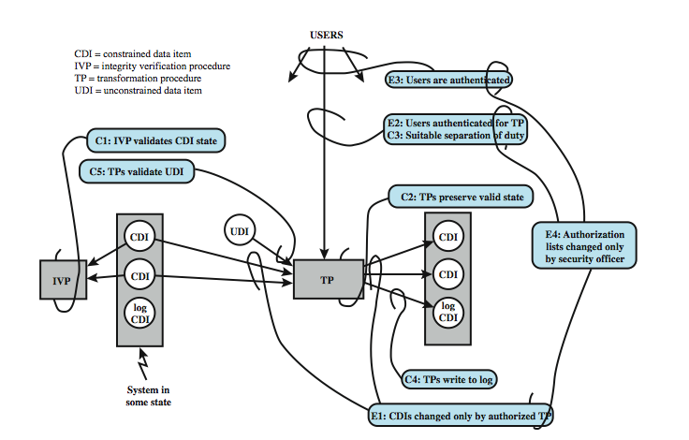
Certification (C) and
Enforcement (E) rules
Notes:
A more elaborate and perhaps more practical integrity model was proposed by Clark and Wilson. The Clark-Wilson model (CWM) is aimed at commercial rather than military applications, and closely models real commercial operations. Figure 10.5 illustrates the rules in this model. The rules combine to form a two-part integrity assurance facility, in which certification is done by a security officer with respect to an integrity policy, and enforcement is done by the system. The rules are:
Cl: All IVPs must ensure all CDIs are in a valid state at the time the IVP is run.
C2: All TPs must be certified to be valid.
El: system must maintain a list of relations from C2, and must ensure manipulation of any CDI is by a TP,as specified in some relation.
E2: system must maintain a list of relations of the form: (UserID, TPi, (CDIa, CDIb, CDIc, . ..)), which relates a user, a TP, and data objects that TP may reference.
C3: list of relations in E2 must be certified to meet the separation of duty requirement.
E3: system must authenticate the identity of each user attempting to execute a TP.
C4: All TPs must be certified to write to an append-only CDI (the log) all info.
C5: Any TP that takes a UDI as an input value must be certified to perform only valid transformations, or else no transformations, for any possible value of the UDI.
E4: Only the agent permitted to certify entities may change the list of such entities associated with other entities.
See text for further details.

Slide 53
The Chinese Wall Model
Hybrid model: addresses integrity and confidentiality
Addresses conflict of interest (CI or CoI)
Model elements
subjects: active entities interested in accessing protected objects
information
objects: individual data items, each about a corp
datasets (DS): all objects concerning one corp
CI class: datasets whose corp are in competition (conflict of interest or CI)
access rules: rules for reading/writing data
Notes:
The Biba [BIBA77] models deals with integrity, and is concerned with the unauthorized modification of data. The basic elements of the Biba model are like the BLP model. As with BLP, the Biba model deals with subjects and objects. Each subject and object is assigned an integrity level, denoted as I(S) and I(O) for subject S and object O, respectively. A simple hierarchical classification can be used, in which there is a strict ordering of levels from lowest to highest. Biba then proposes a number of alternative policies that can be imposed on this model. The most relevant is the strict integrity policy, based on the following rules:
• Simple integrity: A subject can modify an object only if the integrity level of the subject dominates the integrity level of the object: I(S) ≥ I(O).
• Integrity confinement: A subject can read on object only if the integrity level of the subject is dominated by the integrity level of the object: I(S) ≤ I(O).
• Invocation property: A subject can invoke another subject only if the integrity level of the 1st subject dominates the integrity level of the 2nd subject: I(S₁) ≥ I(S₂).
The simple integrity rule is the logical write-up restriction that prevents contamination of high-integrity data. Figure 10.4 illustrates the need for the integrity confinement rule. A low-integrity process may read low-integrity data but is prevented from contaminating a high-integrity file with that data by the simple integrity rule. If only this rule is in force, a high-integrity process could conceivably copy low-integrity data into a high-integrity file. Normally, one would trust a high-integrity process to not contaminate a high-integrity file, but an error in the code or a Trojan horse could result in such contamination. Hence the need for the integrity confinement rule.

Slide 54
The Chinese Wall Model
Not a true multilevel secure model
the history of a subject’s access determines access control
Subjects are only allowed access to info that is not held to conflict with any other info they already possess
Once a subject accesses info from one dataset, a wall is set up to protect info in other datasets in the same CI
Notes:
The Biba [BIBA77] models deals with integrity, and is concerned with the unauthorized modification of data. The basic elements of the Biba model are like the BLP model. As with BLP, the Biba model deals with subjects and objects. Each subject and object is assigned an integrity level, denoted as I(S) and I(O) for subject S and object O, respectively. A simple hierarchical classification can be used, in which there is a strict ordering of levels from lowest to highest. Biba then proposes a number of alternative policies that can be imposed on this model. The most relevant is the strict integrity policy, based on the following rules:
• Simple integrity: A subject can modify an object only if the integrity level of the subject dominates the integrity level of the object: I(S) ≥ I(O).
• Integrity confinement: A subject can read on object only if the integrity level of the subject is dominated by the integrity level of the object: I(S) ≤ I(O).
• Invocation property: A subject can invoke another subject only if the integrity level of the 1st subject dominates the integrity level of the 2nd subject: I(S₁) ≥ I(S₂).
The simple integrity rule is the logical write-up restriction that prevents contamination of high-integrity data. Figure 10.4 illustrates the need for the integrity confinement rule. A low-integrity process may read low-integrity data but is prevented from contaminating a high-integrity file with that data by the simple integrity rule. If only this rule is in force, a high-integrity process could conceivably copy low-integrity data into a high-integrity file. Normally, one would trust a high-integrity process to not contaminate a high-integrity file, but an error in the code or a Trojan horse could result in such contamination. Hence the need for the integrity confinement rule.

Slide 55
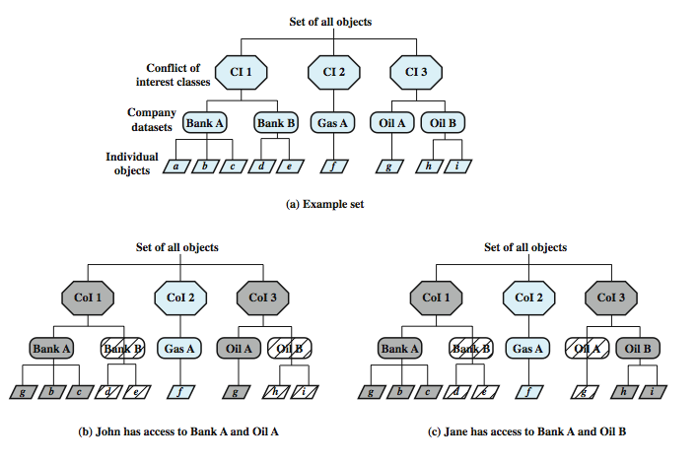
Simple sec rule (read): S can
read O if O is in the same DS as
an object already accessed by S
OR O belongs to a CoI from which
S has not yet accessed any info
*-property (write): S can write
O only if S can read O and all objects
that S can read are in the same DS
as O.
Question: what can John or
Jane write to?
Notes:
The Chinese Wall Model (CWM) takes a quite different approach to specifying integrity and confidentiality than any of the approaches we have examined so far. The model was developed for commercial applications in which conflicts of interest can arise. The principal idea behind the CWM is the use of a Chinese wall to prevent a conflict of interest. Figure 10.6a gives an example. There are datasets representing banks, oil companies, and gas companies. All bank datasets are in one CI, all oil company datasets in another CI, and so forth. In contrast to the models we have studies so far, the history of a subject's previous access determines access control. The basis of the Chinese wall policy is that subjects are only allowed access to information that is not held to conflict with any other information that they already possess. Once a subject accesses information from one dataset, a wall is set up to protect information in other datasets in the same CI. The subject can access information on one side of the wall but not the other side. Further, information in other CIs is initially not considered to be on one side or the other of the wall but out in the open. When additional accesses are made in other CIs by the same subject, the shape of the wall changes to maintain the desired protection. Further, each subject is controlled by his or her own wall - the walls for different subjects are different. To enforce this, two rules are needed:
Simple security rule: A subject S can read on object O only if: O is in the same DS as an object already accessed by S, or O belongs to a CI from which S has not yet accessed any information. Figure 10.6b and c illustrate the operation of this rule.
*-property rule: A subject S can write an object O only if: S can read O according to the simple security rule, and All objects that S can read are in the same DS as O. Thus, in Figure 10.6, neither John nor Jane has write access to any objects.

Slide 56
CW-*-Property
s can write to o iff both of the following hold:
The CW-simple condition permits s to read o
For all unsanitized objects o′, if s can read o′, then CD (o′) = CD (o)
All s can read are either within the same CD, or sanitized
Alice
Bob
Neither Alice nor bob can write
Bank
Gasoline
Citibank
Bank of America
Bank of the West
Shell
Mobil
Sunoco
Texaco

Slide 57
How Does Information Flow?
With the two conditions (CW simple security condition and CW *-property) in place, how can information flow around the system?
Main Results
In each COI class (e.g. Bank), a subject can only read objects in a single CD (e.g. Citibank)
At least n subjects are required to access all objects in a COI class with totally n CDs

Slide 58
How Does Information Flow? (Cont’d)
Information flows from o to o’ if s reads o and writes o’
information in an unsanitized object can only flow inside that CD; information in sanitized objects can flow freely
Citibank
Bank of America
Bank of the West
Shell
Mobil
Sunoco
Texaco
o₃
o₁
o₂
o₃
sanitized
o₁
o₂
o₃
unsanitized

Slide 59
Compare CW to Bell-LaPadula
CW is based on access history, BLP is history-less
BLP can capture CW state at any time, but cannot track changes over time
BLP security levels would need to be updated each time an access is allowed

